Slide 1
Arduino IDE
Install software
Basic functions with examples
Libraries

Slide 2
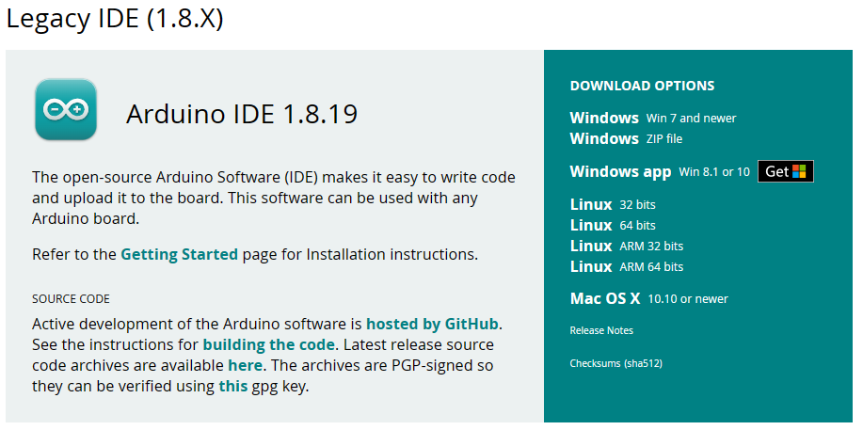
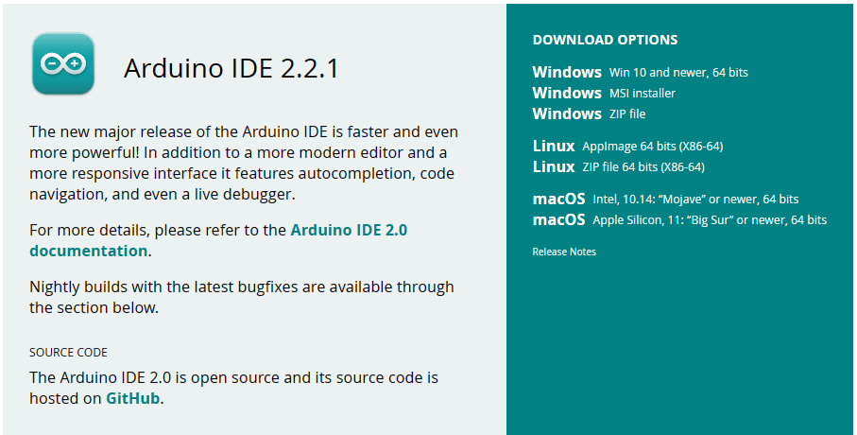
Install software
Software | Arduino
For ESP8266 & 32 the legacy IDE is the better choice.

Slide 3
Arduino builtin functions
Interacting with the serial monitor
Interacting with the physical world

Slide 4
Serial monitor
Serial Communication
Debugging
Data Visualization
User Interaction
Configuration
Basic functions:
Serial.begin(baudrate);
Serial.print();
Serial.println();
Notes:
1:
The Arduino Serial Monitor helps you debug and test your Arduino projects by allowing you to send and receive data through the serial port.
You can use the Serial library in your Arduino code to send messages from your Arduino to the Serial Monitor and vice versa.
2:
When you encounter issues in your Arduino code, you can use the Serial Monitor to print debug information. This can help you understand the flow of your program and identify any errors.
3:
If your Arduino is collecting sensor data or any other form of information, you can use the Serial Monitor to visualize that data in real-time. This is particularly useful for projects involving sensors, as it allows you to observe changes in sensor readings
4:
You can use the Serial Monitor as a simple interface to send commands to your Arduino and receive responses. This is useful for projects where you want to interact with your Arduino in real-time.
5:
Some Arduino projects require configuration parameters to be set. Instead of hardcoding these parameters, you can use the Serial Monitor to send configuration commands or values to your Arduino.
Remember to set the baud rate (baud rate used in the Serial.begin() function in your code) to match the one specified in your Arduino sketch.

Slide 5
digitalWrite

Slide 6
digitalRead

Slide 7
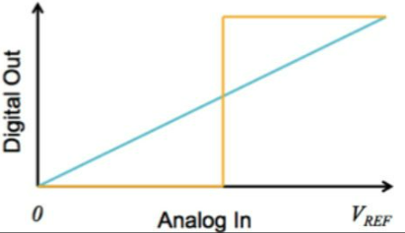
analogRead
Arduino’er har en analog til digital (ADC) converter, til aflæsning af analog sensorer.
Når man læser på analog værdier er det i form af en værdi ‘range’
Arduino’s ADC er 10-bit, med tal imellem 0-1024
Fx (0-5V)→ (0-1024) → (engineering unit)

Slide 8
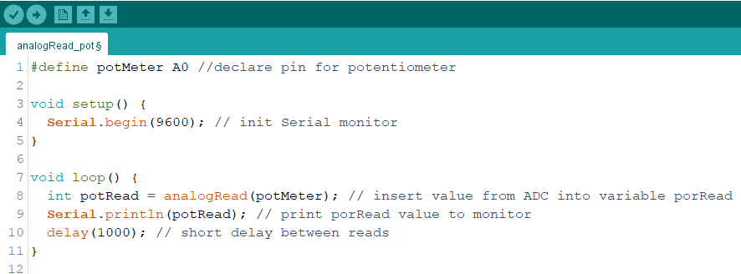
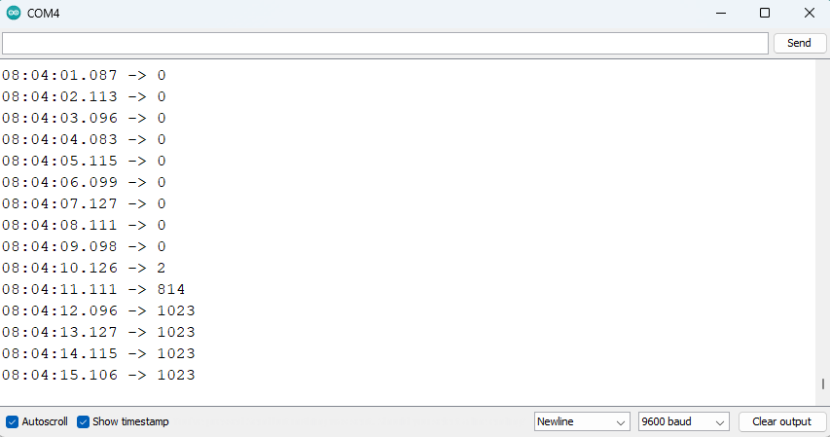
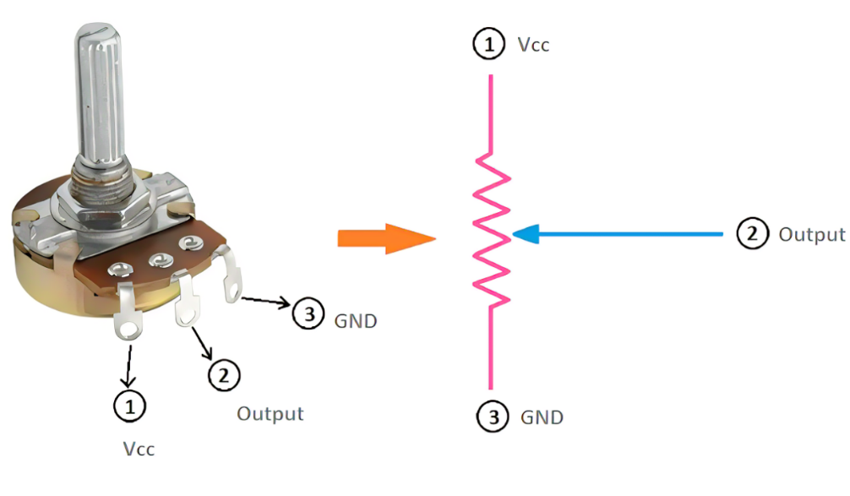
analogRead example
Potentiometer: variabel resistor
ADC: 10 bit (0-1024)

Slide 9
analogWrite
Arduino’er har kun en analog til digital converter og ikke digital to analog.
Analog pins på arduino kan bruges som analog input, digital input og output. Men ikke som et rent analog output.
Vi kan ‘simulerer’ at skrive analog værdier til aktuatorer som en LED, motor etc..
Til dette bruger vi PWM

Slide 10
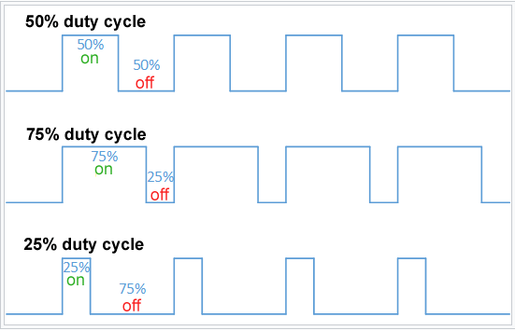
PWM (pulse width modulation)

Slide 11
PWM – ‘for’ loop

